Slide 1
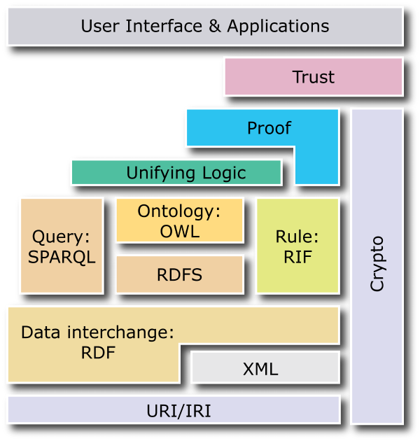

New Semantic « layer cake »
Notes:
Base layers
Base layers comprise the technological standards used in the upper levels:
Unicode to represent characters.
URI (Uniform Resource Identifier): compact string of characters used to identify or name a resource. The main purpose of this identification is to enable interaction with representations of the resource over a network, typically the WWW, using specific protocols. URIs are defined in schemes defining a specific syntax and associated protocols (definition from wikipedia).
XML (eXtended Markup Language) and related technologies, such as NS (Name Spaces) and XML Schema
RDF and RDF Schema.
As the cornerstone of information representation and exchange, RDF defines a simple model to describe any information. RDF is basically a labelled graph representation described by a set of triples (subject, predicate, object).
RDF can be serialized in XML (XML-RDF) but also in more compact formats such as Triples or N3.
RDF Schema extends RDF by adding extension to the basic vocabulary in order to be able to define Class, subClass, properties, subProperties, etc.
Ontology layer
An ontology is a specification of a conceptualization (more complete definition here). In few words, ontology gives the specification of a domain according to a given vocabulary. Usually we can assume that an ontology is defined by classes (objects), properties (attributes or relationships), instances and also various constraints.
Logic layer
Logic became an important aspect of ontologies. Ontology Web Language (OWL), one of the most spread ontology language, is based on Description Logics (DL), which gives high expressive level and provides sound and complete reasoning.
Proof layer
If we take the example of a transaction over the web: let's assume that a computer A send a bill to a computer B: "You owe me $20". Everybody expects the computer B won't give directly the money and say "Why? Prove it". And so the computer A could say: "you bought this book at this store and as you can see it is at this price". Additionally a rule saying that "_when you buy an item you have to pay it"_will finalize the proof. The point is that all these pieces of information are given by RDF triples with references to some URI, so the computer B can check them and if it trusts the referenced site, he can accept the proof. This example goes beyond some criticisms, notably coming the one from Google Executive, Peter Norvig, who challenged T. Berners-Leeduring a conference. It is true that with less human oversight lot of people would attempt to exploit the Semantic Web to make SPAM of get better result to sell you pills of any colored and so it could be difficult to trust such a web. But such comment forgets the concept of proof. Actually what is important is not to say it is the truth, but to give the basis for the other side to know whether this can be the truth according to its beliefs, like we do intuitively when we manually collect data from various location. So have a good grounding is the key: we give the source of the information, so people can decide to trust it or not.

Slide 2
Base Layer
Base Layer
Unicode to represent characters
XML defined in 1998 (syntactic interoperability) and related technologies, such as NS (Name Spaces) and XML Schema
URI (Uniform Resource Identifier): Identification of resources, generalization of URL
Crypto and security layers (HTTPS, etc.)
Notes:
Base layers
Base layers comprise the technological standards used in the upper levels:
Unicode to represent characters.
URI (Uniform Resource Identifier): compact string of characters used to identify or name a resource. The main purpose of this identification is to enable interaction with representations of the resource over a network, typically the WWW, using specific protocols. URIs are defined in schemes defining a specific syntax and associated protocols (definition from wikipedia).
XML (eXtended Markup Language) and related technologies, such as NS (Name Spaces) and XML Schema
RDF and RDF Schema.
As the cornerstone of information representation and exchange, RDF defines a simple model to describe any information. RDF is basically a labelled graph representation described by a set of triples (subject, predicate, object).
RDF can be serialized in XML (XML-RDF) but also in more compact formats such as Triples or N3.
RDF Schema extends RDF by adding extension to the basic vocabulary in order to be able to define Class, subClass, properties, subProperties, etc.
Ontology layer
An ontology is a specification of a conceptualization (more complete definition here). In few words, ontology gives the specification of a domain according to a given vocabulary. Usually we can assume that an ontology is defined by classes (objects), properties (attributes or relationships), instances and also various constraints.
Logic layer
Logic became an important aspect of ontologies. Ontology Web Language (OWL), one of the most spread ontology language, is based on Description Logics (DL), which gives high expressive level and provides sound and complete reasoning.
Proof layer
If we take the example of a transaction over the web: let's assume that a computer A send a bill to a computer B: "You owe me $20". Everybody expects the computer B won't give directly the money and say "Why? Prove it". And so the computer A could say: "you bought this book at this store and as you can see it is at this price". Additionally a rule saying that "_when you buy an item you have to pay it"_will finalize the proof. The point is that all these pieces of information are given by RDF triples with references to some URI, so the computer B can check them and if it trusts the referenced site, he can accept the proof. This example goes beyond some criticisms, notably coming the one from Google Executive, Peter Norvig, who challenged T. Berners-Leeduring a conference. It is true that with less human oversight lot of people would attempt to exploit the Semantic Web to make SPAM of get better result to sell you pills of any colored and so it could be difficult to trust such a web. But such comment forgets the concept of proof. Actually what is important is not to say it is the truth, but to give the basis for the other side to know whether this can be the truth according to its beliefs, like we do intuitively when we manually collect data from various location. So have a good grounding is the key: we give the source of the information, so people can decide to trust it or not.

Slide 3
RDF and RDF Schema Layers
RDF and RDF Schema
RDF: Resource Description Framework
RDF is the cornerstone of information representation and exchange
RDF defines a simple model to describe any information
(details next slides)
Notes:
Base layers
Base layers comprise the technological standards used in the upper levels:
Unicode to represent characters.
URI (Uniform Resource Identifier): compact string of characters used to identify or name a resource. The main purpose of this identification is to enable interaction with representations of the resource over a network, typically the WWW, using specific protocols. URIs are defined in schemes defining a specific syntax and associated protocols (definition from wikipedia).
XML (eXtended Markup Language) and related technologies, such as NS (Name Spaces) and XML Schema
RDF and RDF Schema.
As the cornerstone of information representation and exchange, RDF defines a simple model to describe any information. RDF is basically a labelled graph representation described by a set of triples (subject, predicate, object).
RDF can be serialized in XML (XML-RDF) but also in more compact formats such as Triples or N3.
RDF Schema extends RDF by adding extension to the basic vocabulary in order to be able to define Class, subClass, properties, subProperties, etc.
Ontology layer
An ontology is a specification of a conceptualization (more complete definition here). In few words, ontology gives the specification of a domain according to a given vocabulary. Usually we can assume that an ontology is defined by classes (objects), properties (attributes or relationships), instances and also various constraints.
Logic layer
Logic became an important aspect of ontologies. Ontology Web Language (OWL), one of the most spread ontology language, is based on Description Logics (DL), which gives high expressive level and provides sound and complete reasoning.
Proof layer
If we take the example of a transaction over the web: let's assume that a computer A send a bill to a computer B: "You owe me $20". Everybody expects the computer B won't give directly the money and say "Why? Prove it". And so the computer A could say: "you bought this book at this store and as you can see it is at this price". Additionally a rule saying that "_when you buy an item you have to pay it"_will finalize the proof. The point is that all these pieces of information are given by RDF triples with references to some URI, so the computer B can check them and if it trusts the referenced site, he can accept the proof. This example goes beyond some criticisms, notably coming the one from Google Executive, Peter Norvig, who challenged T. Berners-Leeduring a conference. It is true that with less human oversight lot of people would attempt to exploit the Semantic Web to make SPAM of get better result to sell you pills of any colored and so it could be difficult to trust such a web. But such comment forgets the concept of proof. Actually what is important is not to say it is the truth, but to give the basis for the other side to know whether this can be the truth according to its beliefs, like we do intuitively when we manually collect data from various location. So have a good grounding is the key: we give the source of the information, so people can decide to trust it or not.

Slide 4
Ontology languages
Ontology languages allow users to write explicit, formal conceptualizations of domain models
The main requirements are:
a well-defined syntax
efficient reasoning support
a formal semantics
sufficient expressive power
convenience of expression

Slide 5
Tradeoff between Expressive Power and Efficient Reasoning Support
The richer the language is, the more inefficient the reasoning support becomes
Sometimes it crosses the border of noncomputability
We need a compromise:
A language supported by reasonably efficient reasoners
A language that can express large classes of ontologies and knowledge.

Slide 6
Reasoning About Knowledge in Ontology Languages
Class membership
If x is an instance of a class C, and C is a subclass of D, then we can infer that x is an instance of D
Equivalence of classes
If class A is equivalent to class B, and class B is equivalent to class C, then A is equivalent to C, too

Slide 7
Reasoning About Knowledge in Ontology Languages (2)
Consistency
X instance of classes A and B, but A and B are disjoint
This is an indication of an error in the ontology
Classification
Certain property-value pairs are a sufficient condition for membership in a class A; if an individual x satisfies such conditions, we can conclude that x must be an instance of A

Slide 8
Uses for Reasoning
Reasoning support is important for
checking the consistency of the ontology and the knowledge
checking for unintended relationships between classes
automatically classifying instances in classes
Checks like the preceding ones are valuable for
designing large ontologies, where multiple authors are involved
integrating and sharing ontologies from various sources

Slide 9
Reasoning Support for OWL
Semantics is a prerequisite for reasoning support
Formal semantics and reasoning support are usually provided by
mapping an ontology language to a known logical formalism
using automated reasoners that already exist for those formalisms
OWL is (partially) mapped on a description logic, and makes use of reasoners such as FaCT and RACER
Description logics are a subset of predicate logic for which efficient reasoning support is possible

Slide 10
Limitations of the Expressive Power of RDF Schema
Local scope of properties
rdfs:range defines the range of a property (e.g. eats) for all classes
In RDF Schema we cannot declare range restrictions that apply to some classes only
E.g. we cannot say that cows eat only plants, while other animals may eat meat, too

Slide 11
Limitations of the Expressive Power of RDF Schema (2)
Disjointness of classes
Sometimes we wish to say that classes are disjoint (e.g. male and female)
Boolean combinations of classes
Sometimes we wish to build new classes by combining other classes using union, intersection, and complement
E.g. person is the disjoint union of the classes male and female

Slide 12
Limitations of the Expressive Power of RDF Schema (3)
Cardinality restrictions
E.g. a person has exactly two parents, a course is taught by at least one lecturer
Special characteristics of properties
Transitive property (like “greater than”)
Unique property (like “is mother of”)
A property is the inverse of another property (like “eats” and “is eaten by”)

Slide 13
Combining OWL with RDF Schema
Ideally, OWL would extend RDF Schema
Consistent with the layered architecture of the Semantic Web
But simply extending RDF Schema would work against obtaining expressive power and efficient reasoning
Combining RDF Schema with logic leads to uncontrollable computational properties

Slide 14
Three Species of OWL
W3C’sWeb Ontology Working Group defined OWL as three different sublanguages:
OWL Full
OWL DL
OWL Lite
Each sublanguage geared toward fulfilling different aspects of requirements

Slide 15
OWL Full
It uses all the OWL languages primitives
It allows the combination of these primitives in arbitrary ways with RDF and RDF Schema
OWL Full is fully upward-compatible with RDF, both syntactically and semantically
OWL Full is so powerful that it is undecidable
No complete (or efficient) reasoning support

Slide 16
OWL DL
OWL DL (Description Logic) is a sublanguage of OWL Full that restricts application of the constructors from OWL and RDF
Application of OWL’s constructors’ to each other is disallowed
Therefore it corresponds to a well studied description logic
OWL DL permits efficient reasoning support
But we lose full compatibility with RDF:
Not every RDF document is a legal OWL DL document.
Every legal OWL DL document is a legal RDF document.

Slide 17
OWL Lite
An even further restriction limits OWL DL to a subset of the language constructors
E.g., OWL Lite excludes enumerated classes, disjointness statements, and arbitrary cardinality.
The advantage of this is a language that is easier to
grasp, for users
implement, for tool builders
The disadvantage is restricted expressivity

Slide 18
Upward Compatibility between OWL Species
Every legal OWL Lite ontology is a legal OWL DL ontology
Every legal OWL DL ontology is a legal OWL Full ontology
Every valid OWL Lite conclusion is a valid OWL DL conclusion
Every valid OWL DL conclusion is a valid OWL Full conclusion

Slide 19
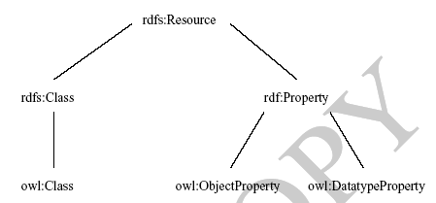
OWL Compatibility with RDF Schema
All varieties of OWL use
RDF for their syntax
Instances are declared
as in RDF, using RDF
descriptions
and typing information
OWL constructors are
specialisations of their
RDF counterparts

Slide 20
OWL Compatibility with RDF Schema (2)
Semantic Web design aims at downward compatibility with corresponding reuse of software across the various layers
The advantage of full downward compatibility for OWL is only achieved for OWL Full, at the cost of computational intractability

Slide 21
Lecture Outline
Basic Ideas of OWL
The OWL Language
Examples
The OWL Namespace
Future Extensions

Slide 22
OWL Syntactic Varieties
OWL builds on RDF and uses RDF’s XML-based syntax
Other syntactic forms for OWL have also been defined:
An alternative, more readable XML-based syntax
An abstract syntax, that is much more compact and readable than the XML languages
A graphic syntax based on the conventions of UML

Slide 23
OWL XML/RDF Syntax: Header
<rdf:RDF
xmlns:owl ="http://www.w3.org/2002/07/owl#"
xmlns:rdf ="http://www.w3.org/1999/02/22-rdf- syntax-ns#"
xmlns:rdfs="http://www.w3.org/2000/01/rdf- schema#"
xmlns:xsd ="http://www.w3.org/2001/ XLMSchema#">
An OWL ontology may start with a collection of assertions for housekeeping purposes using owl:Ontology element

Slide 24
owl:Ontology
<owl:Ontology rdf:about="">
<rdfs:comment>An example OWL ontology </rdfs:comment>
<owl:priorVersion
rdf:resource="http://www.mydomain.org/uni-ns-old"/>
<owl:imports
rdf:resource="http://www.mydomain.org/persons"/>
<rdfs:label>University Ontology</rdfs:label>
</owl:Ontology>
owl:imports is a transitive property

Slide 25
Classes
Classes are defined using owl:Class
owl:Class is a subclass of rdfs:Class
Disjointness is defined using owl:disjointWith
<owl:Class rdf:about="#associateProfessor">
<owl:disjointWith rdf:resource="#professor"/>
<owl:disjointWith rdf:resource="#assistantProfessor"/>
</owl:Class>

Slide 26
AcademicStaffMember
Owl:ObjectProperty
givenBy inverse de GivesaCourse
Owl:DataTypeProperty
hasAge: NonNegativeInteger
Course
Person
Class
Owl:DataTypeProperty
ID: NonNegativeInteger
Sub-classOf
Owl:ObjectProperty
GivesaCourse
Faculty
Sub-classOf
Sub-classOf
Sub-classOf
Associate professor
Professor
Assistant Professor
disjointWith
disjointWith

Slide 27
Classes (2)
owl:equivalentClass defines equivalence of classes
<owl:Class rdf:ID="faculty">
<owl:equivalentClass rdf:resource= "#academicStaffMember"/>
</owl:Class>
owl:Thing is the most general class, which contains everything
owl:Nothing is the empty class

Slide 28
Properties
In OWL there are two kinds of properties
Object properties, which relate objects to other objects
E.g. is-TaughtBy, supervises
Data type properties, which relate objects to datatype values
E.g. phone, title, age, etc.

Slide 29
Datatype Properties
OWL makes use of XML Schema data types, using the layered architecture of the SW
<owl:DatatypeProperty rdf:ID="age">
<rdfs:range rdf:resource= "http://www.w3.org/2001/XLMSchema
#nonNegativeInteger"/>
</owl:DatatypeProperty>

Slide 30
Object Properties
User-defined data types
<owl:ObjectProperty rdf:ID="isTaughtBy">
<owl:domain rdf:resource="#course"/>
<owl:range rdf:resource= "#academicStaffMember"/>
<rdfs:subPropertyOf rdf:resource="#involves"/>
</owl:ObjectProperty>

Slide 31
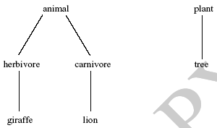
An African Wildlife Ontology – Class Hierarchy

Slide 32
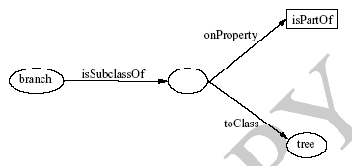
An African Wildlife Ontology – Schematic Representation
Βranches are parts of trees:
Une Branche c’est quelque chose qui fait partie de l’arbre

Slide 33
Βranches partOf Tree
Βranches partOf Conifer
Owl:DataTypeProperty
hasAge: NonNegativeInteger
Tree
Class
Sub-classOf
Owl:ObjectProperty
is-part-of
Conifer
Βranche

Slide 34
An African Wildlife Ontology – Properties
<owl:TransitiveProperty rdf:ID="is-part-of"/>
<owl:ObjectProperty rdf:ID="eats">
<rdfs:domain rdf:resource="#animal"/>
</owl:ObjectProperty>
<owl:ObjectProperty rdf:ID="eaten-by">
<owl:inverseOf rdf:resource="#eats"/>
</owl:ObjectProperty>

Slide 35
Animal eats
eatenBy is inverseOf eats
Is partOf has a caracteristic: TransitiveProperty
Is partOf has a type : ObjectProperty
Owl:ObjectProperty
eats
Plant
Sub-classOf
disjointWith
Animal
Owl:DataTypeProperty
hasAge: NonNegativeInteger
Tree
Class
Owl:ObjectProperty
eatenBy
Sub-classOf
Conifer
Βranche

Slide 36
An African Wildlife Ontology – Plants and Trees
<owl:Class rdf:ID="plant">
<owl:disjointWith rdf:resource="#animal"/>
</owl:Class>
<owl:Class rdf:ID="tree">
<rdfs:subClassOf rdf:resource="#plant"/>
</owl:Class>

Slide 37
Inverse Properties
<owl:ObjectProperty rdf:ID="teaches">
<rdfs:range rdf:resource="#course"/>
<rdfs:domain rdf:resource= "#academicStaffMember"/>
<owl:inverseOf rdf:resource="#isTaughtBy"/>
</owl:ObjectProperty>

Slide 38
Equivalent Properties
owl:equivalentProperty
<owl:ObjectProperty rdf:ID="lecturesIn">
<owl:equivalentProperty rdf:resource="#teaches"/>
</owl:ObjectProperty>

Slide 39
AcademicStaffMember
Owl:ObjectProperty
isTaughtBy inverse of Teaches
Owl:DataTypeProperty
hasAge: NonNegativeInteger
Course
Person
Class
Owl:DataTypeProperty
ID: NonNegativeInteger
Sub-classOf
Owl:ObjectProperty
Teaches <=> lecturesIn
Faculty
Sub-classOf
Sub-classOf
Sub-classOf
Associate professor
Professor
Assistant Professor
disjointWith
disjointWith

Slide 40
Règle 1 : Si le potentiel de sol est fort OU la pluviométrie est forte alors le rendement est fort
Règle 2 : Si le potentiel de sol est moyen, alors le rendement est moyen
Règle 3 : Si le potentiel de sol est faible ET la pluviométrie est faible, alors le rendement est faible

Slide 41
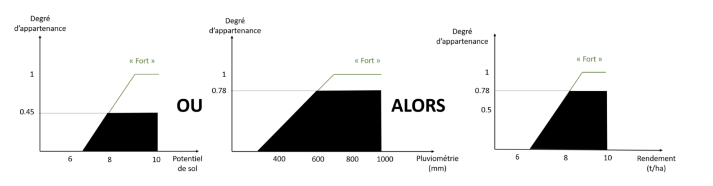
Decision si R1 activé : si et seulement si le potentiel de sol est fort OU la pluviométrie est forte
Input:
potentiel de sol = fort ( 8 ),
pluviométrie « forte », (600mm)

Slide 42
Property Restrictions
In OWL we can declare that the class C satisfies certain conditions
All instances of C satisfy the conditions
This is equivalent to saying that C is subclass of a class C', where C' collects all objects that satisfy the conditions
C' can remain anonymous

Slide 43
Property Restrictions (2)
A (restriction) class is achieved through an owl:Restriction element
This element contains an owl:onProperty element and one or more restriction declarations
One type defines cardinality restrictions (at least one, at most 3,…)

Slide 44
Property Restrictions (3)
The other type defines restrictions on the kinds of values the property may take
owl:allValuesFrom specifies universal quantification
owl:hasValue specifies a specific value
owl:someValuesFrom specifies existential quantification

Slide 45
owl:allValuesFrom
<owl:Class rdf:about="#firstYearCourse">
<rdfs:subClassOf>
<owl:Restriction>
<owl:onProperty rdf:resource="#isTaughtBy"/>
<owl:allValuesFrom rdf:resource="#Professor"/>
</owl:Restriction>
</rdfs:subClassOf>
</owl:Class>

Slide 46
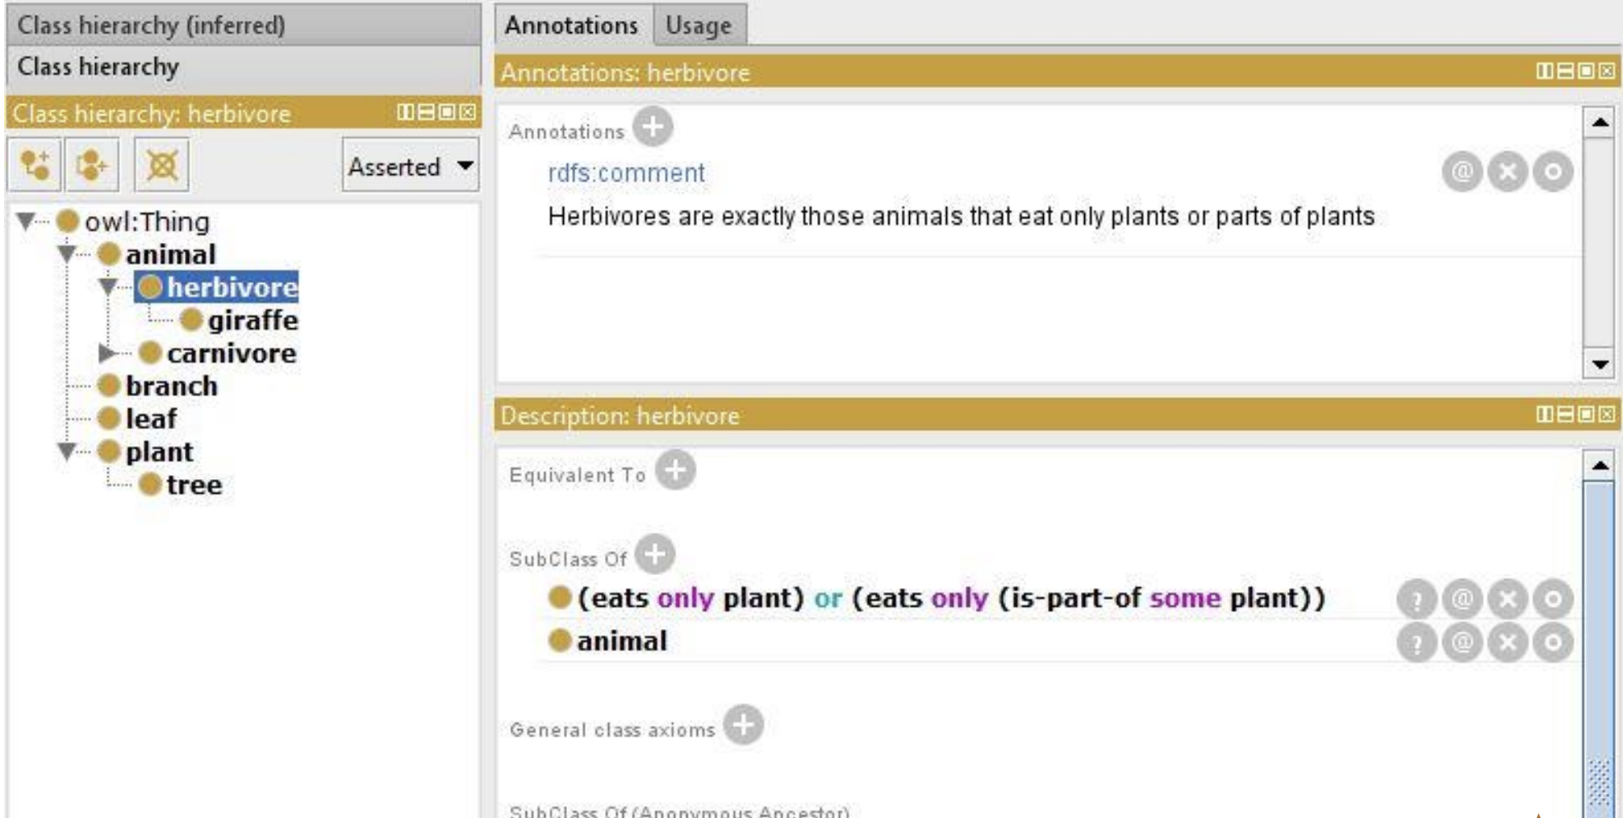
allValuesFrom

Slide 47
owl:hasValue
<owl:Class rdf:about="#mathCourse">
<rdfs:subClassOf>
<owl:Restriction>
<owl:onProperty rdf:resource= "#isTaughtBy"/>
<owl:hasValue rdf:resource= "#949352"/>
</owl:Restriction>
</rdfs:subClassOf>
</owl:Class>

Slide 48
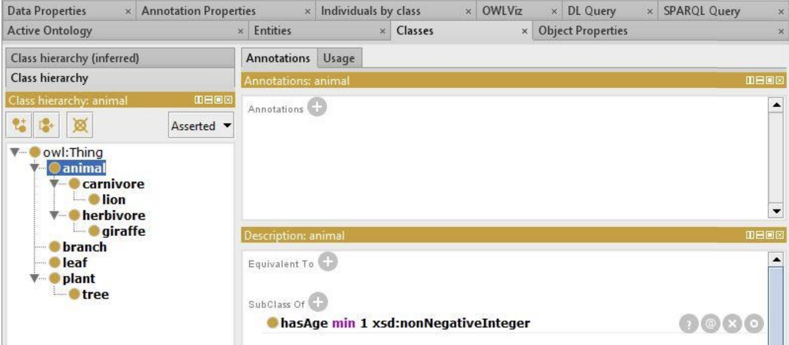
hasValue

Slide 49
owl:someValuesFrom
<owl:Class rdf:about="#academicStaffMember">
<rdfs:subClassOf>
<owl:Restriction>
<owl:onProperty rdf:resource="#teaches"/>
<owl:someValuesFrom rdf:resource= "#undergraduateCourse"/>
</owl:Restriction>
</rdfs:subClassOf>
</owl:Class>

Slide 50
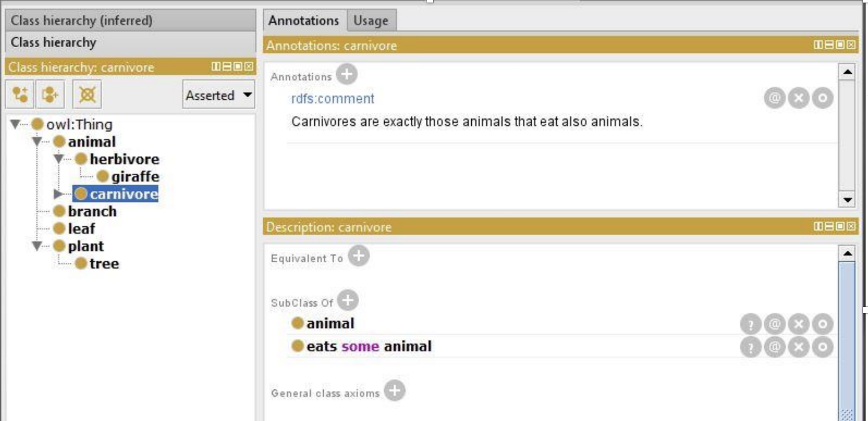
someValuesFrom

Slide 51
Cardinality Restrictions
We can specify minimum and maximum number using owl:minCardinality and owl:maxCardinality
It is possible to specify a precise number by using the same minimum and maximum number
For convenience, OWL offers also owl:cardinality

Slide 52
Cardinality Restrictions (2)
<owl:Class rdf:about="#course">
<rdfs:subClassOf>
<owl:Restriction>
<owl:onProperty rdf:resource="#isTaughtBy"/>
<owl:minCardinality rdf:datatype= "&xsd;nonNegativeInteger">
1
</owl:minCardinality>
</owl:Restriction>
</rdfs:subClassOf>
</owl:Class>

Slide 53
Special Properties
owl:TransitiveProperty (transitive property)
E.g. “has better grade than”, “is ancestor of”
owl:SymmetricProperty (symmetry)
E.g. “has same grade as”, “is sibling of”
owl:FunctionalProperty defines a property that has at most one value for each object
E.g. “age”, “height”, “directSupervisor”
owl:InverseFunctionalProperty defines a property for which two different objects cannot have the same value

Slide 54
Special Properties (2)
<owl:ObjectProperty rdf:ID="hasSameGradeAs">
<rdf:type rdf:resource="&owl;TransitiveProperty"/>
<rdf:type rdf:resource="&owl;SymmetricProperty"/>
<rdfs:domain rdf:resource="#student"/>
<rdfs:range rdf:resource="#student"/>
</owl:ObjectProperty>

Slide 55
John, Mike, Bob is-instance-Of Student
John hasSameGradeAs Mike
Mike hasSameGradeAs Bob
----------------------------------------
John hasSameGradeAs Bob
Bob hasSameGradeAs Mike
Bob hasSameGradeAs John
Person
Class
Sub-classOf
Student
Owl:ObjectProperty::SymmetricProperty:: TransitiveProperty
hasSameGradeAs

Slide 56
SPARQL : CWA
RDF (S, Predicate, Object)
Graph Pattern Matching
SELECT Bob hasSameGradeAs ?Student
Bob hasSameGradeAs Mike
Bob hasSameGradeAs John
Person
Class
Sub-classOf
Student
Owl:ObjectProperty::SymmetricProperty:: TransitiveProperty
hasSameGradeAs

Slide 57
Boolean Combinations
We can combine classes using Boolean operations (union, intersection, complement)
<owl:Class rdf:about="#course">
<rdfs:subClassOf>
<owl:Restriction>
<owl:complementOf rdf:resource= "#staffMember"/>
</owl:Restriction>
</rdfs:subClassOf>
</owl:Class>

Slide 58
Boolean Combinations (2)
<owl:Class rdf:ID="peopleAtUni">
<owl:unionOf rdf:parseType="Collection">
<owl:Class rdf:about="#staffMember"/>
<owl:Class rdf:about="#student"/>
</owl:unionOf>
</owl:Class>
The new class is not a subclass of the union, but rather equal to the union
We have stated an equivalence of classes

Slide 59
peopleAtUni
Is Equivalent to
staffMember
Collection: unionOf
student

Slide 60
Boolean Combinations (3)
<owl:Class rdf:ID="facultyInCS">
<owl:intersectionOf rdf:parseType="Collection">
<owl:Class rdf:about="#faculty"/>
<owl:Restriction>
<owl:onProperty rdf:resource="#belongsTo"/>
<owl:hasValue rdf:resource= "#CSDepartment"/>
</owl:Restriction>
</owl:intersectionOf>
</owl:Class>

Slide 61
facultyInCS
Department
Is Equivalent to
faculty
Collection: intersectionOf
Sub-classOf
CSDepartment
Blank Node
Owl:ObjectProperty:
belongsTo

Slide 62
Nesting of Boolean Operators
<owl:Class rdf:ID="adminStaff">
<owl:intersectionOf rdf:parseType="Collection">
<owl:Class rdf:about="#staffMember"/>
<owl: Class>
<owl:complementOf>
<owl: Class>
<owl:unionOf rdf:parseType="Collection">
<owl:Class rdf:about="#faculty"/>
<owl:Class rdf:about=#techSupportStaff"/>
</owl:unionOf>
</owl: Class>
</owl:complementOf>
</owl: Class>
</owl:intersectionOf>
</owl:Class>

Slide 63
adminStaff
staffMember
Collection: intersectionOf
Is Equivalent to
Blank Node
faculty
Collection: unionOf
Is Equivalent to
techSupportStaff

Slide 64
Enumerations with owl:oneOf
<owl:Class rdf:ID="weekdays">
<owl:oneOf rdf:parseType="Collection">
<owl:Thing rdf:about="#Monday"/>
<owl:Thing rdf:about="#Tuesday"/>
<owl:Thing rdf:about="#Wednesday"/>
<owl:Thing rdf:about="#Thursday"/>
<owl:Thing rdf:about="#Friday"/>
<owl:Thing rdf:about="#Saturday"/>
<owl:Thing rdf:about="#Sunday"/>
</owl:oneOf>
</owl:Class>

Slide 65
mathCourse isTaughtBy 949352
<owl:Class rdf:about="#mathCourse">
<rdfs:subClassOf>
<owl:Restriction>
<owl:onProperty rdf:resource= "#isTaughtBy"/>
<owl:hasValue rdf:resource= "#949352"/>
</owl:Restriction>
</rdfs:subClassOf>
</owl:Class>

Slide 66
Declaring Instances
Instances of classes are declared as in RDF:
<rdf:Description rdf:ID="949352">
<rdf:type rdf:resource= "#academicStaffMember"/>
</rdf:Description>
<academicStaffMember rdf:ID="949352">
<uni:age rdf:datatype="&xsd;integer"> 39<uni:age>
</academicStaffMember>

Slide 67
No Unique-Names Assumption
OWL does not adopt the unique-names assumption of database systems
If two instances have a different name or ID does not imply that they are different individuals
Suppose we state that each course is taught by at most one staff member, and that a given course is taught by two staff members
An OWL reasoner does not flag an error
Instead it infers that the two resources are equal

Slide 68
Table 1
KeyA
KeyB
Att1.1
Att1.2
Table 2
KeyB
Att2.1
Att2.2
1,Math,15,15/09/2022
1,Math, 20/01/2023
2,Math,15,20/01/2023
1,English, 15

Slide 69
Distinct Objects
To ensure that different individuals are indeed recognized as such, we must explicitly assert their inequality:
<lecturer rdf:about="949318">
<owl:differentFrom rdf:resource="949352"/>
</lecturer>

Slide 70
Distinct Objects (2)
OWL provides a shorthand notation to assert the pairwise inequality of all individuals in a given list
<owl:allDifferent>
<owl:distinctMembers rdf:parseType="Collection">
<lecturer rdf:about="949318"/>
<lecturer rdf:about="949352"/>
<lecturer rdf:about="949111"/>
</owl:distinctMembers>
</owl:allDifferent>

Slide 71
Data Types in OWL
XML Schema provides a mechanism to construct user-defined data types
E.g., the data type of adultAge includes all integers greater than 18
Such derived data types cannot be used in OWL
The OWL reference document lists all the XML Schema data types that can be used
These include the most frequently used types such as string, integer, Boolean, time, and date.

Slide 72
Versioning Information
owl:priorVersion indicates earlier versions of the current ontology
No formal meaning, can be exploited for ontology management
owl:versionInfo generally contains a string giving information about the current version, e.g. keywords

Slide 73
Versioning Information (2)
owl:backwardCompatibleWith contains a reference to another ontology
All identifiers from the previous version have the same intended interpretations in the new version
Thus documents can be safely changed to commit to the new version
owl:incompatibleWith indicates that the containing ontology is a later version of the referenced ontology but is not backward compatible with it

Slide 74
Combination of Features
In different OWL languages there are different sets of restrictions regarding the application of features
In OWL Full, all the language constructors may be used in any combination as long as the result is legal RDF

Slide 75
Restriction of Features in OWL DL
Vocabulary partitioning
Any resource is allowed to be only a class, a data type, a data type property, an object property, an individual, a data value, or part of the built-in vocabulary, and not more than one of these
Explicit typing
The partitioning of all resources must be stated explicitly (e.g. a class must be declared if used in conjunction with rdfs:subClassOf)

Slide 76
Restriction of Features in OWL DL (2)
Property Separation
The set of object properties and data type properties are disjoint
Therefore the following can never be specified for data type properties:
owl:inverseOf
owl:FunctionalProperty
owl:InverseFunctionalProperty
owl:SymmetricProperty

Slide 77
Restriction of Features in OWL DL (3)
No transitive cardinality restrictions
No cardinality restrictions may be placed on transitive properties
Restricted anonymous classes: Anonymous classes are only allowed to occur as:
the domain and range of either owl:equivalentClass or owl:disjointWith
the range (but not the domain) of rdfs:subClassOf

Slide 78
Restriction of Features in OWL Lite
Restrictions of OWL DL and more
owl:oneOf, owl:disjointWith, owl:unionOf, owl:complementOf and owl:hasValue are not allowed
Cardinality statements (minimal, maximal, and exact cardinality) can only be made on the values 0 or 1
owl:equivalentClass statements can no longer be made between anonymous classes but only between class identifiers

Slide 79
Inheritance in Class Hierarchies
Range restriction: Courses must be taught by academic staff members only
Michael Maher is a professor
He inherits the ability to teach from the class of academic staff members
This is done in RDF Schema by fixing the semantics of “is a subclass of”
It is not up to an application (RDF processing software) to interpret “is a subclass of

Slide 80
OWL DLP
OWL is based on Description Logic
Description Logic is a fragment of first-order logic
OWL inherits from Description Logic
The open-world assumption
The non-unique-name assumption

Slide 81
Open-world assumption
We cannot conclude some statement x to be false simply because we cannot show x to be true
Our axioms may be simply noncommittal on the status of x
We may not deduce falsity from the absence of truth

Slide 82
Open-world assumption example
Question: "Did it rain in Tokyo yesterday?"
Answer: "I don’t know that it rained , but that’s not enough reason to conclude that it didn’t rain"

Slide 83
Closed-world assumption (CWA)
Closed-world assumption allow deriving falsity from the inability to derive truth
Example:
Question: " Was there a big earthquake disaster in Tokyo yesterday? "
Answer: " I don’t know that there was, but if there had been such a disaster, I’d have heard about it. Therefore I conclude that there wasn’t such a disaster"

Slide 84
Unique-name assumption (UNA)
When two individuals are known by different names, they are in fact different individuals
This is an assumption that sometimes works (ex. Product codes) and sometimes doesn’t (ex. Social environment)
OWL does not make the unique-name assumption

Slide 85
OWL DLP use
Systems such as databases and logic-programming systems have tended to support closed worlds and unique names
Knowledge representation systems and theorem plovers support open worlds and non-unique names

Slide 86
OWL DLP use (2)
Ontologies are sometimes in need of one sometimes in need of the other use
Discussions can be found in the literature and on the WWW about whither OWL should be more like a knowledge representation system or more like a database system
This debate was nicely resolved by Volz and Horrocks, who identified a fragment of OWL called DLP
This fragment in the largest fragment on which the choice for CWA and UNA does not matter, see following figure

Slide 87
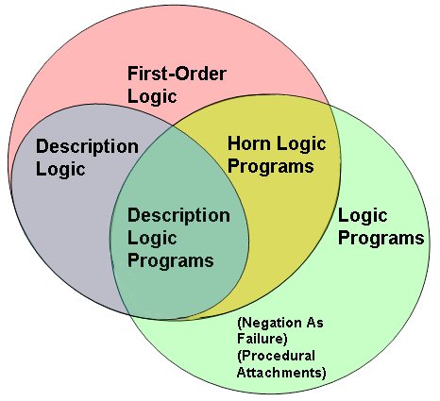
Relation of OWL DLP to other languages

Slide 88
OWL DLP use (3)
OWL DLP is weak enough so that the differences between the choices don’t show up
The advantage of this is that people or applications that wish to make different choices on these assumptions can still exchange ontologies in OWL DLP without harm
As soon as they go outside OWL DLP, they will notice that they draw different conclusions from the same statements

Slide 89
OWL DLP
DLP is still large enough to enable useful representation and reasoning tasks
It allows the use of such OWL constructors as:
Class and property equivalence
Equality and inequality between individuals
Inverse, transitive, symmetric and functional properties
The intersection of classes
It excludes constructors such as :
Intersection and arbitrary cardinality constraints

Slide 90
OWL DLP
These constructors not only allow useful expressivity for many practical cases, while guaranteeing correct interchange between OWL reasoners independent of CWA and UNA, but also allow for translation into efficiently implementable reasoning techniques based on databases and logic programs

Slide 91
Lecture Outline
Basic Ideas of OWL
The OWL Language
Examples
The OWL Namespace
Future Extensions

Slide 92
An African Wildlife Ontology – Class Hierarchy

Slide 93
An African Wildlife Ontology – Schematic Representation
Βranches are parts of trees

Slide 94
An African Wildlife Ontology – Properties
<owl:TransitiveProperty rdf:ID="is-part-of"/>
<owl:ObjectProperty rdf:ID="eats">
<rdfs:domain rdf:resource="#animal"/>
</owl:ObjectProperty>
<owl:ObjectProperty rdf:ID="eaten-by">
<owl:inverseOf rdf:resource="#eats"/>
</owl:ObjectProperty>

Slide 95
An African Wildlife Ontology – Plants and Trees
<owl:Class rdf:ID="plant">
<rdfs:comment>Plants form a class disjoint from animals. </rdfs:comment>
<owl:disjointWith rdf:resource="#animal"/>
</owl:Class>
<owl:Class rdf:ID="tree">
<rdfs:comment>Trees are a type of plant. </rdfs:comment>
<rdfs:subClassOf rdf:resource="#plant"/>
</owl:Class>

Slide 96
An African Wildlife Ontology – Branches
<owl:Class rdf:ID="branch">
<rdfs:comment>Branches are parts of trees. </rdfs:comment>
<rdfs:subClassOf>
<owl:Restriction>
<owl:onProperty rdf:resource="#is-part-of"/>
<owl:allValuesFrom rdf:resource="#tree"/>
</owl:Restriction>
</rdfs:subClassOf>
</owl:Class>

Slide 97
Βranches partOf Tree
What are the parts of a Tree ➔ Root et Branch
What are the parts of a Conifer ➔ Root et Branch
Root
Owl:ObjectProperty
Has-part >=< is-part-of
Owl:DataTypeProperty
hasAge: NonNegativeInteger
Βranch
Tree
Sub-classOf
Sub-classOf
Conifer
BlankNode
Owl:ObjectProperty
is-part-of
>=< Inverseof
<=> equivalenTo
:: characteristic

Slide 98
Leaves are parts of branches.
Leaf
Root
Sub-classOf
BlankNode
Owl:DataTypeProperty
hasAge: NonNegativeInteger
Owl:ObjectProperty
Has-part >=< is-part-of
Owl:ObjectProperty
is-part-of
Βranch
Tree
Sub-classOf
Sub-classOf
Conifer
BlankNode
Owl:ObjectProperty
is-part-of
>=< Inverseof
<=> equivalenTo
:: characteristic

Slide 99
An African Wildlife Ontology – Leaves
<owl:Class rdf:ID="leaf">
<rdfs:comment>Leaves are parts of branches. </rdfs:comment>
<rdfs:subClassOf>
<owl:Restriction>
<owl:onProperty rdf:resource="#is-part-of"/>
<owl:allValuesFrom rdf:resource="#branch"/>
</owl:Restriction>
</rdfs:subClassOf>
</owl:Class>

Slide 100
An African Wildlife Ontology – Carnivores
<owl:Class rdf:ID="carnivore">
<rdfs:comment> Carnivores are exactly those animals
that eat animals.</rdfs:comment>
<owl:intersectionOf rdf:parsetype="Collection">
<owl:Class rdf:about="#animal"/>
<owl:Restriction>
<owl:onProperty rdf:resource="#eats"/>
<owl:someValuesFrom rdf:resource="#animal"/>
</owl:Restriction>
</owl:intersectionOf>
</owl:Class>

Slide 101
Animal is something that eats animals or something that eats plants
Animal
Owl:ObjectProperty
eats
Blank Node
Collection: UnionOf
Owl:ObjectProperty
eats
Blank Node
Plant

Slide 102
carnivore
animal
Collection: intersectionOf
Owl:ObjectProperty
eats
Blank Node

Slide 103
Omnivore is an animal that eats animals and is an animal that eats plants
Omnivore
Animal
Collection: IntersectionOf
Owl:ObjectProperty
eats
Is Equivalent to
Blank Node
Blank Node
Owl:ObjectProperty
eats
Plant

Slide 104
Omnivore is an animal that eats animals and is an animal that eats plants
Omnivore
Animal
Sub-classOf
Collection: IntersectionOf
Owl:ObjectProperty
eats
Is Equivalent to
Blank Node
Blank Node
Owl:ObjectProperty
eats
Plant

Slide 105
An African Wildlife Ontology – Herbivores
<owl:Class rdf:ID="herbivore">
<rdfs:comment>
Herbivores are exactly those animals
that eat only plants or parts of plants. </rdfs:comment>
<rdfs:comment>
Try it out! See book for code.
<rdfs:comment>
</owl:Class>

Slide 106
An African Wildlife Ontology – Herbivores
<owl:Class rdf:ID="herbivore">
<rdfs:comment>
Herbivores are exactly those animals
that eat only plants or parts of plants. </rdfs:comment>
<owl:intersectionOf rdf:parsetype="Collection">
<owl:Class rdf:about="#animal"/>
<owl:Restriction>
<owl:onProperty rdf:resource="#eats"/>
<owl:someValuesFrom rdf:resource="#plant"/>
</owl:Restriction>
</owl:intersectionOf>
</owl:Class>

Slide 107
Herbivores are exactly those animals that eat only plants or parts of plants.
Herbivore
animal
Collection: IntersectionOf
Is Equivalent to
Sub-classOf
Restriction: someValuesFrom
Collection: UnionOf
Owl:ObjectProperty
eats
Blank Node
Blank Node
Plant
Owl:ObjectProperty
Part-Of
Owl:ObjectProperty
eats

Slide 108
Herbivores are exactly those animals ( that eat only plants or leaves)
Herbivore
animal
Collection: IntersectionOf
Blank Node
Is Equivalent to
Leaf
Collection: UnionOf
Owl:ObjectProperty
eats
Blank Node
Plant
Blank Node
Owl:ObjectProperty
eats

Slide 109
An African Wildlife Ontology – Herbivores
<owl:Class rdf:ID="herbivore">
<owl:intersectionOf rdf:parsetype="Collection">
<owl:Class rdf:about="#animal"/>
<owl:Restriction>
<owl:onProperty rdf:resource="#eats"/>
<owl:someValuesFrom rdf:resource="#plant"/>
</owl:Restriction>
<owl:Restriction>
<owl:onProperty rdf:resource="#eats"/>
<owl:Restriction>
<owl:onProperty rdf:resource="#is-part-of"/>
<owl:allValuesFrom rdf:resource="#plant"/>
</owl:Restriction>
</rdfs:subClassOf>
</owl:intersectionOf>
</owl:Class>

Slide 110
An African Wildlife Ontology – Giraffes
<owl:Class rdf:ID="giraffe">
<rdfs:comment>Giraffes are herbivores, and they
eat only leaves.</rdfs:comment>
<rdfs:subClassOf rdf:type="#herbivore"/>
<rdfs:subClassOf>
<owl:Restriction>
<owl:onProperty rdf:resource="#eats"/>
<owl:allValuesFrom rdf:resource="#leaf"/>
</owl:Restriction>
</rdfs:subClassOf>
</owl:Class>

Slide 111
An African Wildlife Ontology – Lions
<owl:Class rdf:ID="lion">
<rdfs:comment>Lions are carnivores that eat
only herbivores.</rdfs:comment>
<rdfs:subClassOf rdf:type="#carnivore"/>
<rdfs:subClassOf>
<owl:Restriction>
<owl:onProperty rdf:resource="#eats"/>
<owl:allValuesFrom rdf:resource="#herbivore"/>
</owl:Restriction>
</rdfs:subClassOf>
</owl:Class>

Slide 112
Lions are carnivores that eat only herbivores
Carniovre
Sub-classOf
Lion
Restriction:
allValuesFrom
Sub-classOf
Owl:ObjectProperty
eats
Herbivore

Slide 113
An African Wildlife Ontology – Tasty Plants
owl:Class rdf:ID="tasty-plant">
<rdfs:comment>Tasty plants are plants that are eaten both by herbivores and carnivores </rdfs:comment>
<rdfs:subClassOf rdf:type="#plant"/>
<rdfs:subClassOf>
<owl:Restriction>
<owl:onProperty rdf:resource="# eaten"/>
<owl:allValuesFrom rdf:resource="#herbivore"/>
<owl:onProperty rdf:resource="# eaten"/>
<owl:allValuesFrom rdf:resource="#carnivore"/>
</owl:Restriction>
</rdfs:subClassOf>
</owl:Class>

Slide 114
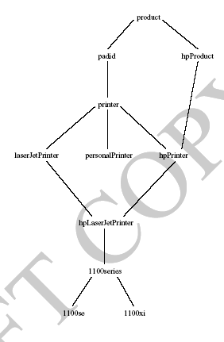
A Printer Ontology – Class Hierarchy

Slide 115
A Printer Ontology – Products and Devices
<owl:Class rdf:ID="product">
<rdfs:comment>Products form a class. </rdfs:comment>
<rdfs:subClassOf rdf:type="#Thing"/>
</owl:Class>
<owl:Class rdf:ID="padid">
<rdfs:comment>Printing and digital imaging devices
form a subclass of products.</rdfs:comment>
<rdfs:label>Device</rdfs:label>
<rdfs:subClassOf rdf:resource="#product"/>
</owl:Class>

Slide 116
A Printer Ontology – HP Products
<owl:Class rdf:ID="hpProduct">
<owl:intersectionOf rdf:parseType=“Collection">
<owl:Class rdf:about="#product"/>
<owl:Restriction>
<owl:onProperty rdf:resource="#manufactured_by"/>
<owl:hasValue rdf:datatype=“&xsd;string">
Hewlett Packard
</owl:hasValue>
</owl:Restriction>
</owl:intersectionOf>
</owl:Class>

Slide 117
A Printer Ontology – Printers and Personal Printers
<owl:Class rdf:ID="printer">
<rdfs:comment>Printers are printing and digital imaging
devices.</rdfs:comment>
<rdfs:subClassOf rdf:resource="#padid"/>
</owl:Class>
<owl:Class rdf:ID="personalPrinter">
<rdfs:comment>Printers for personal use form
a subclass of printers.</rdfs:comment>
<rdfs:subClassOf rdf:resource="#printer"/>
</owl:Class>

Slide 118
A Printer Ontology – HP LaserJet 1100se Printers
<owl:Class rdf:ID="1100se">
<rdfs:comment>1100se printers belong to the 1100 series
and cost $450.</rdfs:comment>
<rdfs:subClassOf rdf:resource="#1100series"/>
<rdfs:subClassOf>
<owl:Restriction>
<owl:onProperty rdf:resource="#price"/>
<owl:hasValue rdf:datatype="&xsd;integer">
450
</owl:hasValue>
</owl:Restriction>
</rdfs:subClassOf>
</owl:Class>

Slide 119
A Printer Ontology – Properties
<owl:DatatypeProperty rdf:ID="manufactured_by">
<rdfs:domain rdf:resource="#product"/>
<rdfs:range rdf:resource="&xsd;string"/>
</owl:DatatypeProperty>
<owl:DatatypeProperty rdf:ID="printingTechnology">
<rdfs:domain rdf:resource="#printer"/>
<rdfs:range rdf:resource="&xsd;string"/>
</owl:DatatypeProperty>

Slide 120
Lecture Outline
Basic Ideas of OWL
The OWL Language
Examples
The OWL Namespace
Future Extensions

Slide 121
OWL in OWL
We present a part of the definition of OWL in terms of itself
The following captures some of OWL’s meaning in OWL
It does not capture the entire semantics
A separate semantic specification is necessary
The URI of the OWL definition is defined as the default namespace

Slide 122
Classes of Classes (Metaclasses)
The class of all OWL classes is itself a subclass of the class of all RDF Schema classes:
<rdfs:Class rdf:ID="Class">
<rdfs:label>Class</rdfs:label>
<rdfs:subClassOf rdf:resource="&rdfs;Class"/>
</rdfs:Class>

Slide 123
Classes of Classes (Metaclasses) – Thing and Nothing
Thing is most general object class in OWL
Nothing is most specific class: the empty object class
The following relationships hold:

Slide 124
Classes of Classes (Metaclasses) – Thing and Nothing (2)
<Class rdf:ID="Thing">
<rdfs:label>Thing</rdfs:label>
<unionOf rdf:parseType="Collection">
<Class rdf:about="#Nothing"/>
<Class>
<complementOf rdf:resource="#Nothing"/>
</Class>
</unionOf>
</Class>
<Class rdf:ID="Nothing">
<rdfs:label>Nothing</rdfs:label>
<complementOf rdf:resource="#Thing"/>
</Class>

Slide 125
Class and Property Equivalences
<rdf:Property rdf:ID="EquivalentClass">
<rdfs:label>EquivalentClass</rdfs:label>
<rdfs:subPropertyOf rdf:resource="&rdfs;subClassOf"/>
<rdfs:domain rdf:resource="#Class"/>
<rdfs:range rdf:resource="#Class"/>
</rdf:Property>
<rdf:Property rdf:ID="EquivalentProperty">
<rdfs:label>EquivalentProperty</rdfs:label>
<rdfs:subPropertyOf rdf:resource="&rdfs;subPropertyOf"/>
</rdf:Property>

Slide 126
Class Disjointness
<rdf:Property rdf:ID="disjointWith">
<rdfs:label>disjointWith</rdfs:label>
<rdfs:domain rdf:resource="#Class"/>
<rdfs:range rdf:resource="#Class"/>
</rdf:Property>

Slide 127
Equality and Inequality
Equality and inequality can be stated between arbitrary things
In OWL Full this statement can also be applied to classes
Properties sameIndividualAs, sameAs and differentFrom

Slide 128
Equality and Inequality (2)
<rdf:Property rdf:ID="sameIndividualAs">
<rdfs:domain rdf:resource="#Thing"/>
<rdfs:range rdf:resource="#Thing"/>
</rdf:Property>
<rdf:Property rdf:ID="sameAs">
<EquivalentProperty rdf:resource= "#sameIndividualAs"/>
</rdf:Property>

Slide 129
Union and Intersection of Classes
Build a class from a list, assumed to be a list of other class expressions
<rdf:Property rdf:ID="unionOf">
<rdfs:domain rdf:resource="#Class"/>
<rdfs:range rdf:resource="&rdf;List"/>
</rdf:Property>

Slide 130
Restriction Classes
Restrictions in OWL define the class of those objects that satisfy some attached conditions
<rdfs:Class rdf:ID="Restriction">
<rdfs:label>Restriction</rdfs:label>
<rdfs:subClassOf rdf:resource="#Class"/>
</rdfs:Class>

Slide 131
Restriction Properties
All the following properties (onProperty, allValuesFrom, minCardinality, etc.) are only allowed to occur within a restriction definition
Their domain is owl:Restriction, but they differ with respect to their range

Slide 132
Restriction Properties (2)
<rdf:Property rdf:ID="onProperty">
<rdfs:label>onProperty</rdfs:label>
<rdfs:domain rdf:resource="#Restriction"/>
<rdfs:range rdf:resource="&rdf;Property"/>
</rdf:Property>
<rdf:Property rdf:ID="allValuesFrom">
<rdfs:label>allValuesFrom</rdfs:label>
<rdfs:domain rdf:resource="#Restriction"/>
<rdfs:range rdf:resource="&rdfs;Class"/>
</rdf:Property>

Slide 133
Restriction Properties (3)
<rdf:Property rdf:ID="hasValue">
<rdfs:label>hasValue</rdfs:label>
<rdfs:domain rdf:resource="#Restriction"/>
</rdf:Property>
<rdf:Property rdf:ID=”maxCardinality">
<rdfs:label>maxCardinality</rdfs:label>
<rdfs:domain rdf:resource="#Restriction"/>
<rdfs:range rdf:resource= "&xsd;nonNegativeInteger"/>
</rdf:Property>

Slide 134
Properties
owl:ObjectProperty and owl:DatatypeProperty are special cases of rdf:Property
<rdfs:Class rdf:ID="ObjectProperty">
<rdfs:label>ObjectProperty</rdfs:label>
<rdfs:subClassOf rdf:resource="&rdf;Property"/>
</rdfs:Class>

Slide 135
Properties (2)
Symmetric, functional and inverse functional properties can only be applied to object properties
<rdfs:Class rdf:ID="TransitiveProperty">
<rdfs:label>TransitiveProperty</rdfs:label>
<rdfs:subClassOf rdf:resource= "#ObjectProperty"/>
</rdfs:Class>

Slide 136
Properties (3)
owl:inverseOf relates two object properties:
<rdf:Property rdf:ID="inverseOf">
<rdfs:label>inverseOf</rdfs:label>
<rdfs:domain rdf:resource="#ObjectProperty"/>
<rdfs:range rdf:resource="#ObjectProperty"/>
</rdf:Property>

Slide 137
Lecture Outline
Basic Ideas of OWL
The OWL Language
Examples
The OWL Namespace
Future Extensions

Slide 138
Extensions of OWL
Modules and Imports
Defaults
Closed World Assumption
Unique Names Assumption
Procedural Attachments
Rules for Property Chaining

Slide 139
Modules and Imports
The importing facility of OWL is very trivial:
It only allows importing of an entire ontology, not parts of it
Modules in programming languages based on information hiding: state functionality, hide implementation details
Open question how to define appropriate module mechanism for Web ontology languages

Slide 140
Defaults
Many practical knowledge representation systems allow inherited values to be overridden by more specific classes in the hierarchy
treat inherited values as defaults
No consensus has been reached on the right formalization for the nonmonotonic behaviour of default values

Slide 141
Closed World Assumption
OWL currently adopts the open-world assumption:
A statement cannot be assumed true on the basis of a failure to prove it
On the huge and only partially knowable WWW, this is a correct assumption
Closed-world assumption: a statement is true when its negation cannot be proved
tied to the notion of defaults, leads to nonmonotonic behaviour

Slide 142
Unique Names Assumption
Typical database applications assume that individuals with different names are indeed different individuals
OWL follows the usual logical paradigm where this is not the case
Plausible on the WWW
One may want to indicate portions of the ontology for which the assumption does or does not hold

Slide 143
Procedural Attachments
A common concept in knowledge representation is to define the meaning of a term by attaching a piece of code to be executed for computing the meaning of the term
Not through explicit definitions in the language
Although widely used, this concept does not lend itself very well to integration in a system with a formal semantics, and it has not been included in OWL

Slide 144
Rules for Property Chaining
OWL does not allow the composition of properties for reasons of decidability
In many applications this is a useful operation
One may want to define properties as general rules (Horn or otherwise) over other properties
Integration of rule-based knowledge representation and DL-style knowledge representation is currently an active area of research

Slide 145
Summary
OWL is the proposed standard for Web ontologies
OWL builds upon RDF and RDF Schema:
(XML-based) RDF syntax is used
Instances are defined using RDF descriptions
Most RDFS modeling primitives are used

Slide 146
Summary (2)
Formal semantics and reasoning support is provided through the mapping of OWL on logics
Predicate logic and description logics have been used for this purpose
While OWL is sufficiently rich to be used in practice, extensions are in the making
They will provide further logical features, including rules

